Slide 1
Finite State Machines

Slide 2
Overview
A finite-state machine (FSM) or finite-state automaton (FSA, plural: automata), finite automaton, or simply a state machine is a model of computation
It is an abstract machine that can be in exactly one of a finite number of states at any given time.

Slide 3
The FSM can change from one state to another in response to some external inputs; the change from one state to another is called a transition.
An FSM is defined by a list of its states, its initial state, and the conditions for each transition.

Slide 4
States
Start state:
End state
(accepting)
General state

Slide 5
Acceptors
A useful application of FSMs is to test that the input is a matching sequence. These are often referred to as Acceptors.
Acceptors are FSMs with
Empty output
One or more states marked as “accepting”, i.e. end states
Input sequence is accepted if it can generate a trace from the start state to an accepting state.
The language accepted by an (acceptor) FSM is the set of all input sequences which it accepts.

Slide 6
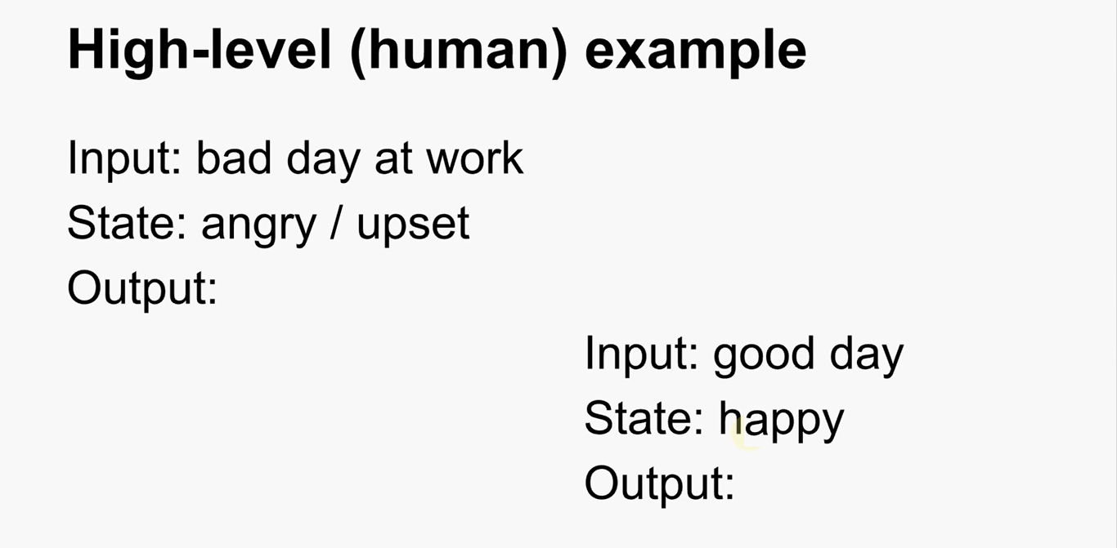

Slide 7
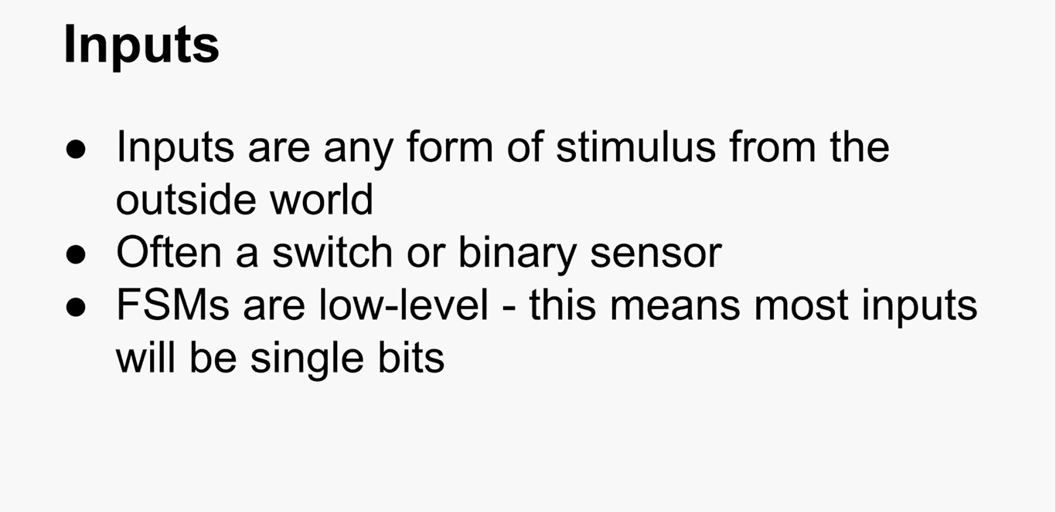

Slide 8
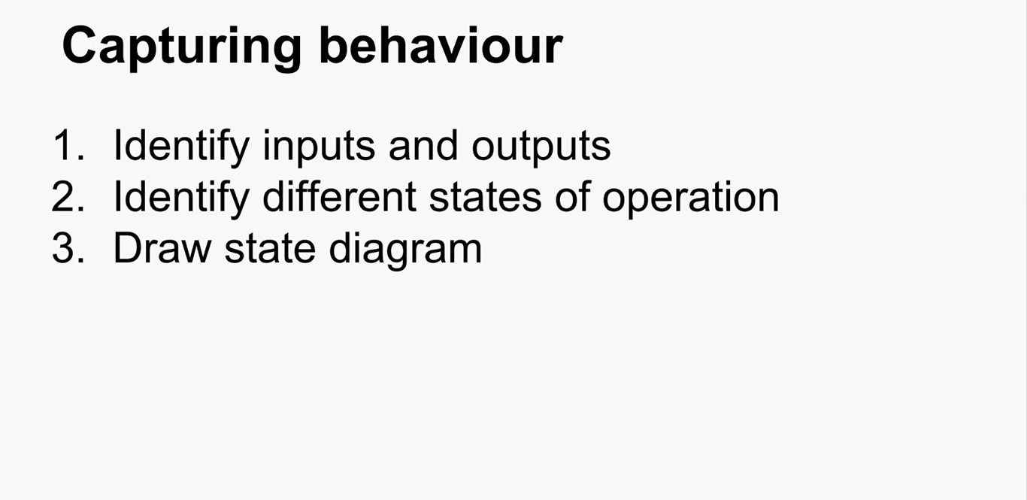

Slide 9
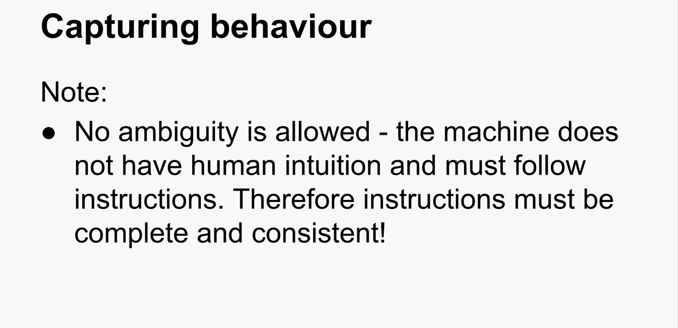

Slide 10
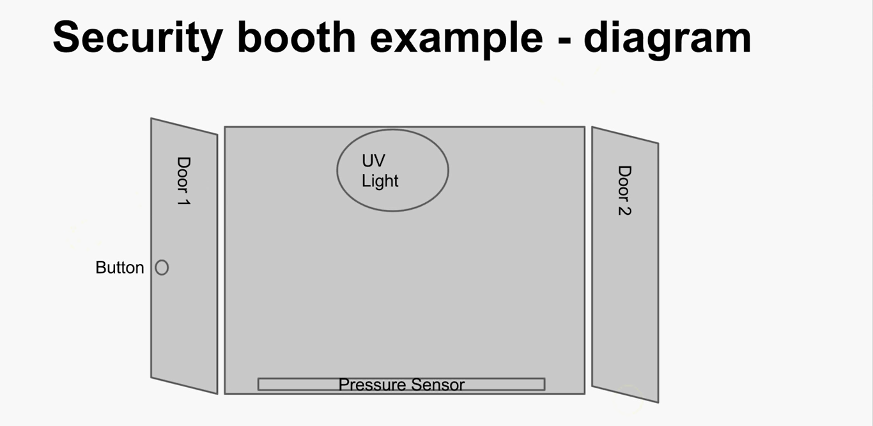

Slide 11
Security booth example - behavior
The booth should do nothing and wait for an input
If a person presses the button the door 1 should open to admit the person, then closes again.
If a person is, then deducted in booth UV decontamination should occur. Otherwise, the booth should do nothing.

Slide 12
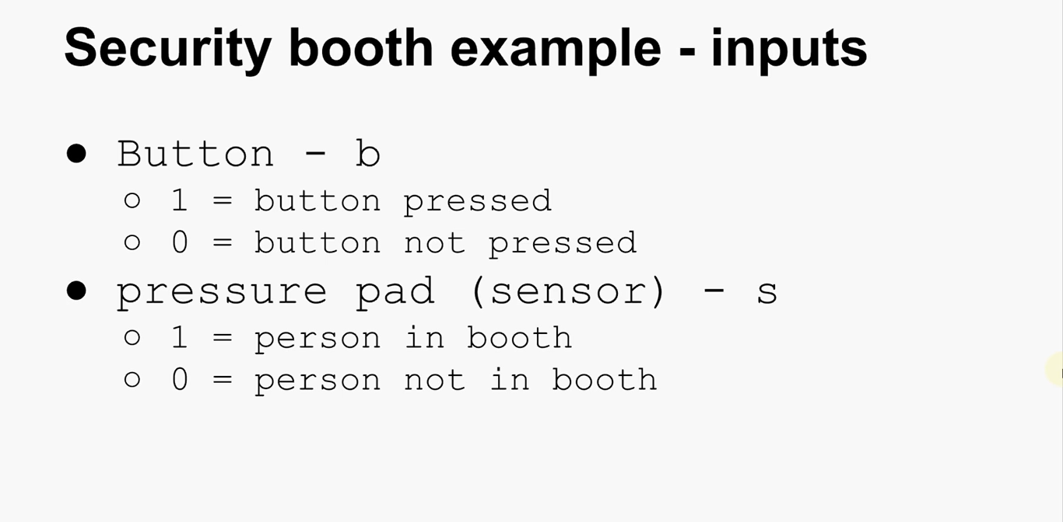

Slide 13
Security booth example - outputs
Door 1 – d1
1 = door open
0 = door closed
Door 2 – d2
1 = door open
0 = door closed
UV light = l
1 = light on
0 = light off

Slide 14
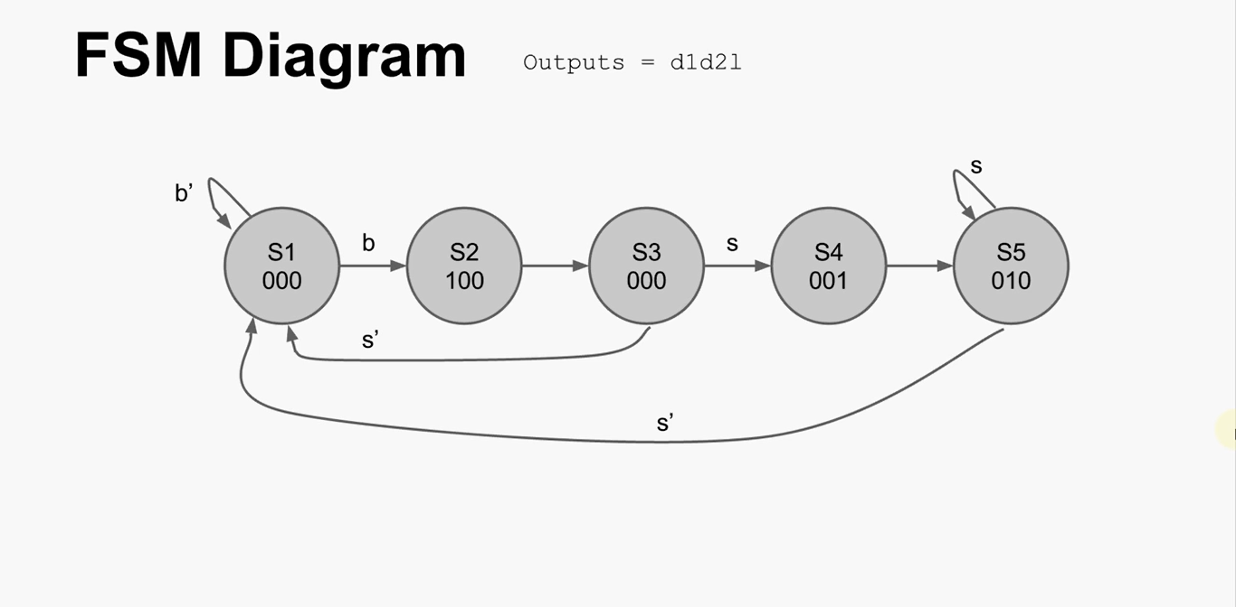

Slide 15
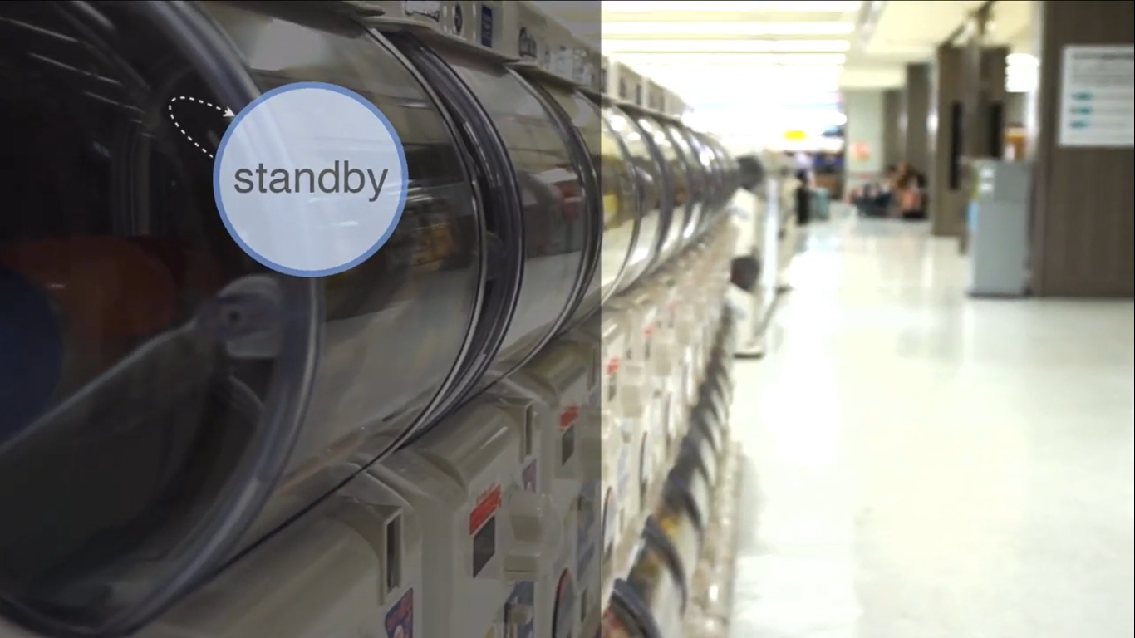

Slide 16
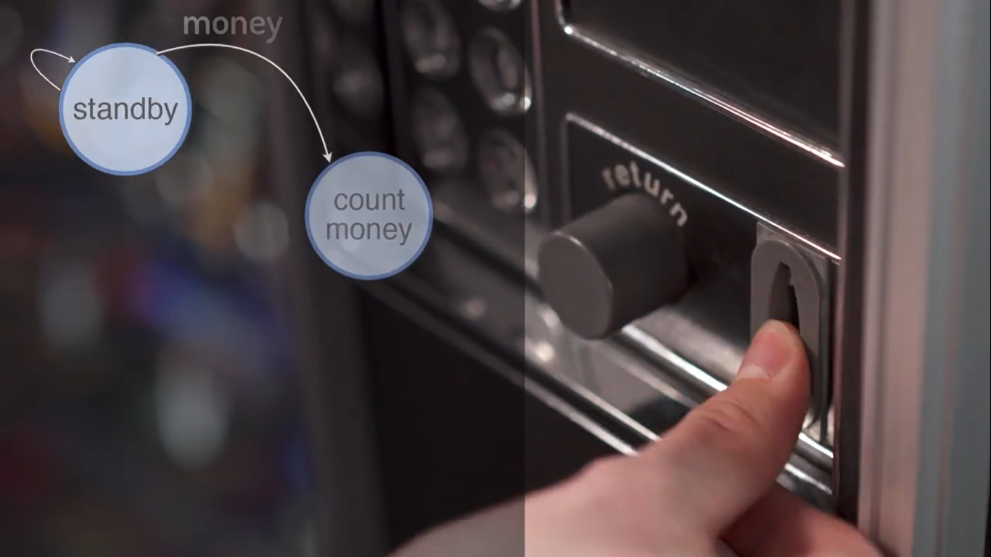

Slide 17
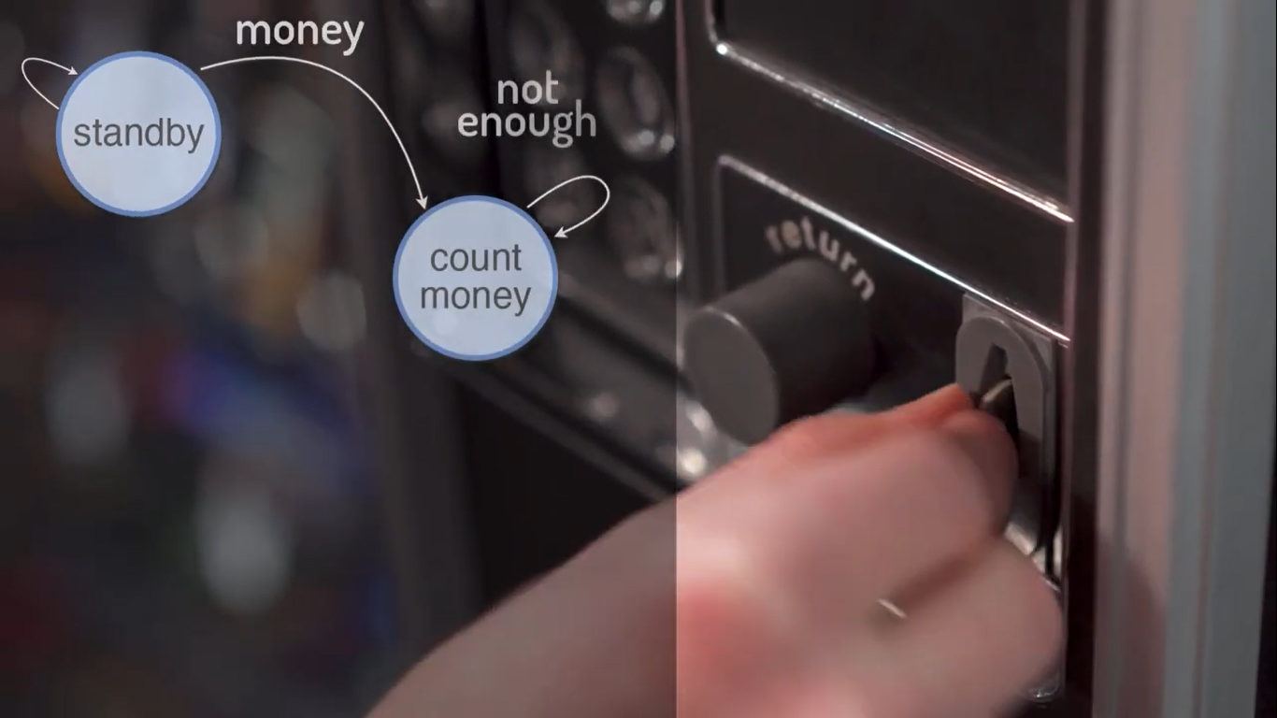

Slide 18
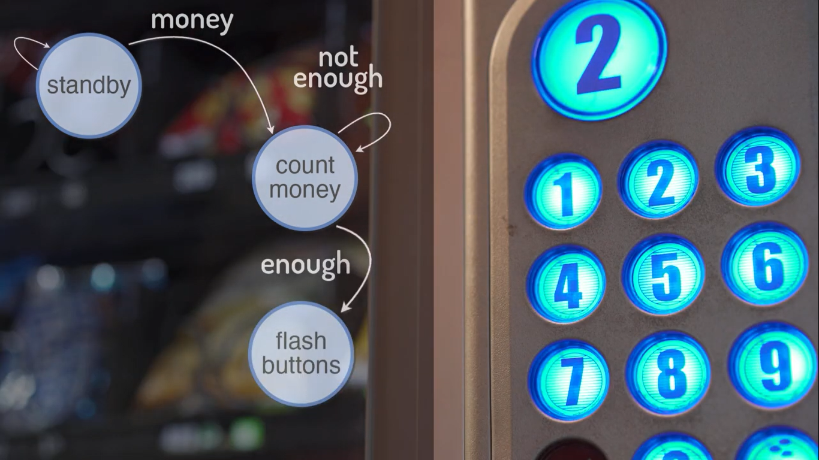

Slide 19
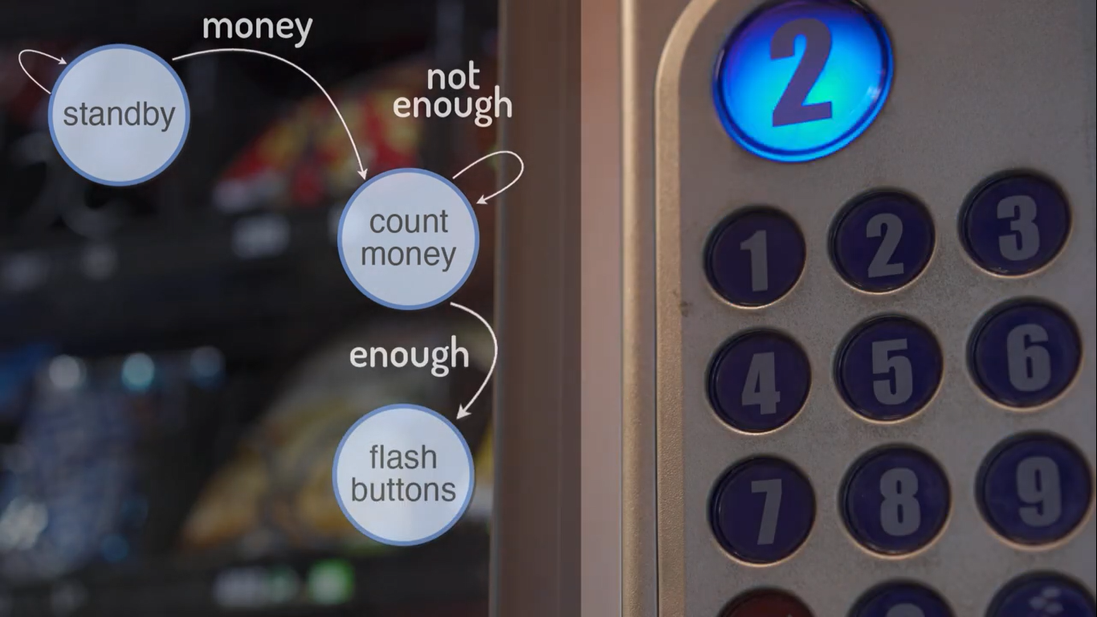

Slide 20
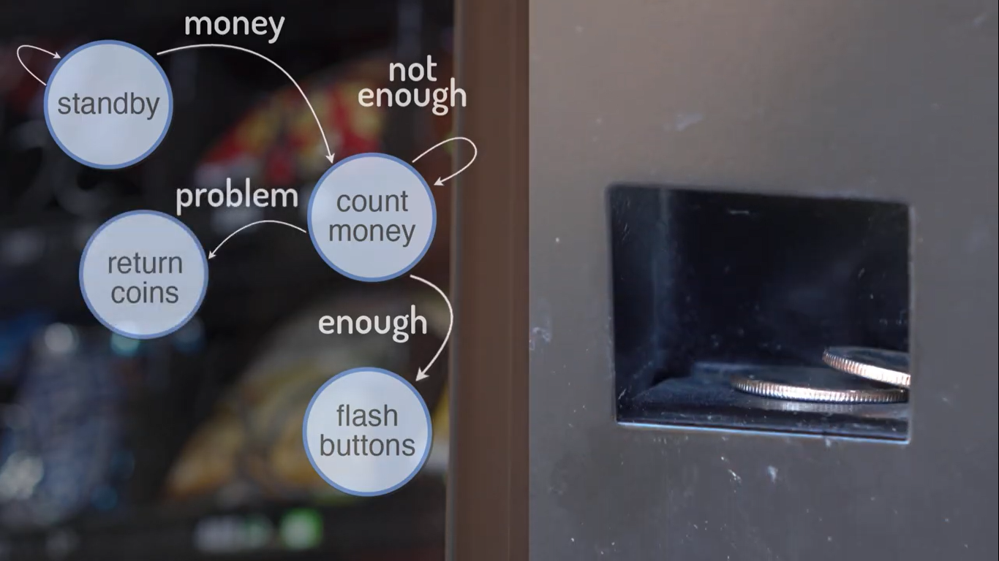

Slide 21
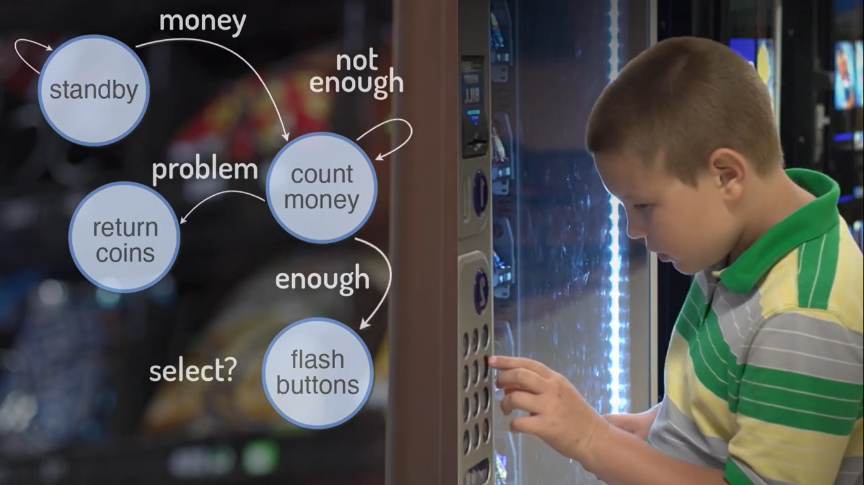

Slide 22
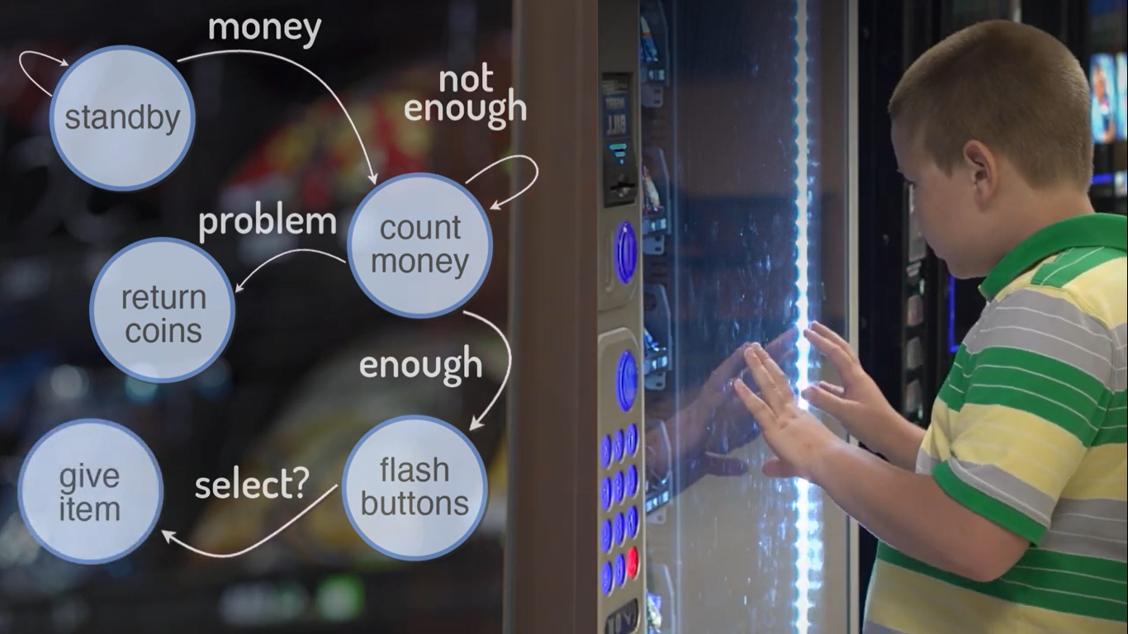

Slide 23
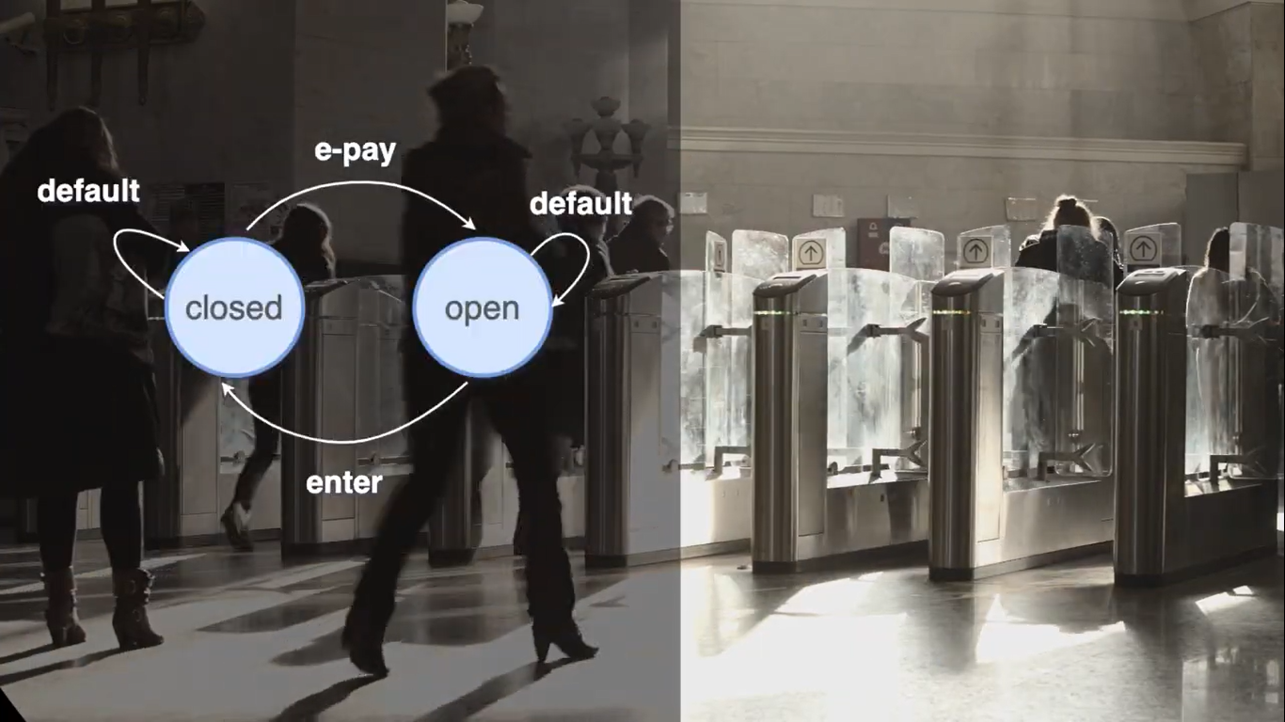

Slide 24
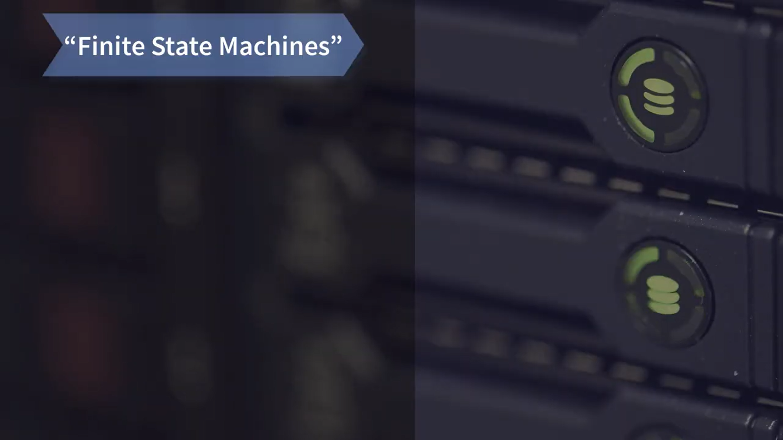

Slide 25
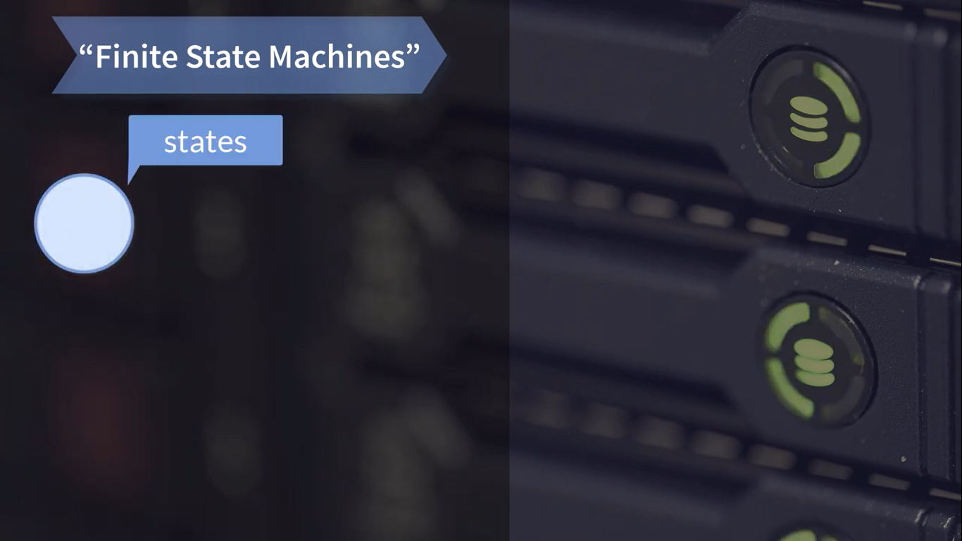

Slide 26


Slide 27
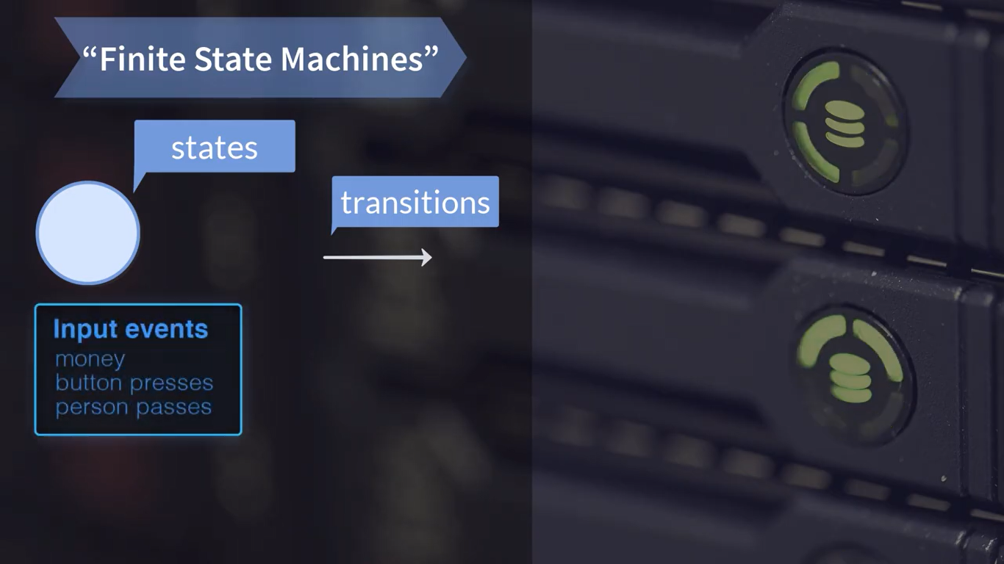

Slide 28
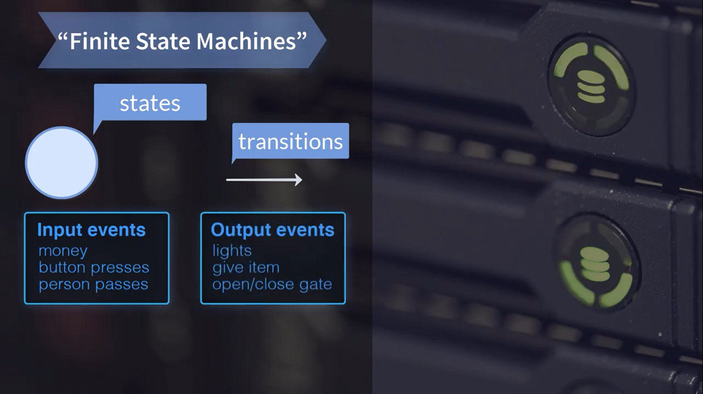

Slide 29
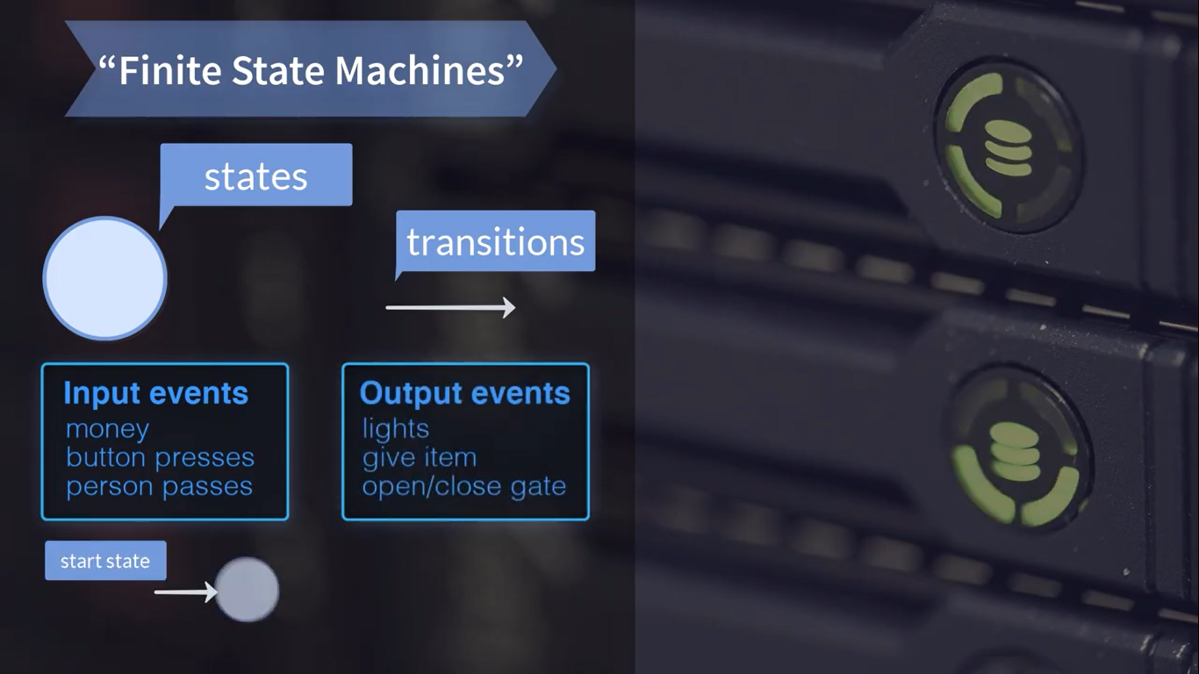

Slide 30
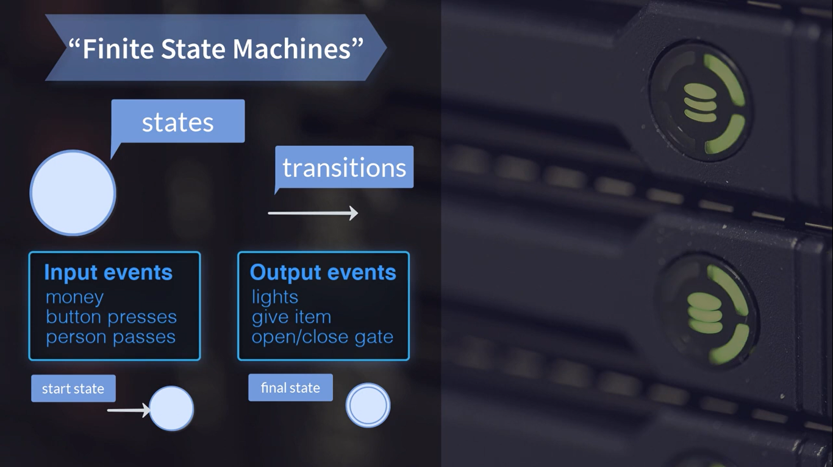

Slide 31


Slide 32


Slide 33
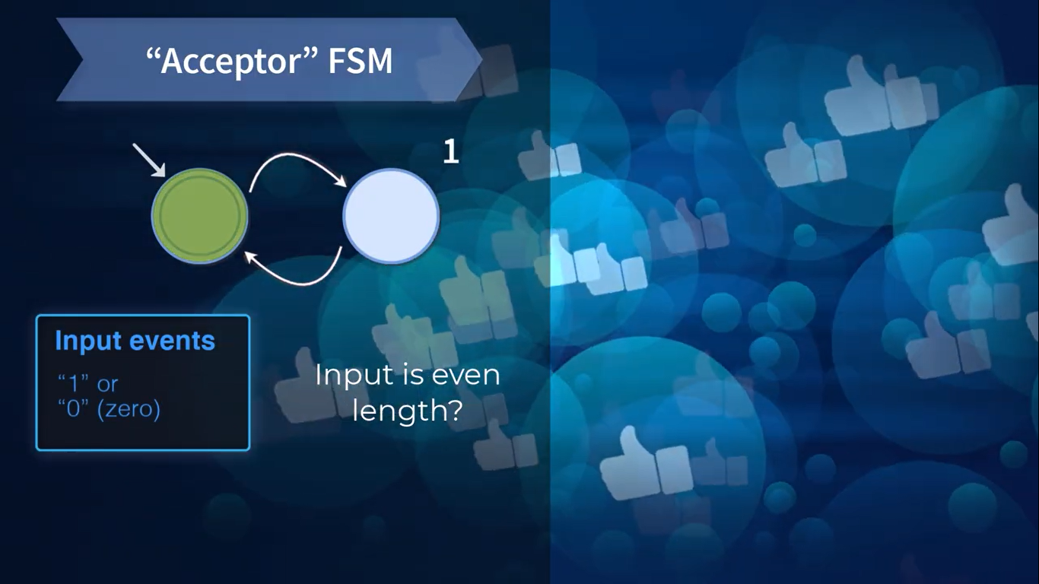

Slide 34


Slide 35
Accepts strings of 0s and 1s, in which the numbers of 0s so far never exceeds the number of 1s so far by more than one and vice versa

Slide 36
Output using Moore machines*
It can be useful to output values as part of a transition
A Moore machine is an FSM whose output depends on the current state, represented diagrammatically as:
Where S is the name of the state, I is the input, and O is the output
* Moore E. F. Gedanken-experiments on Sequential Machines. Automata Studies, Annals of
Mathematical Studies, 34, 129–153. Princeton University Press, Princeton, N.J.(1956).

Slide 37
Example 3: even numbers
Accepts even binary numbers, outputting matched digits

Slide 38
Determinism
FSMs in which for every state, there is at most one transition leaving the state for each input symbol are called determinstic.
Other FSMs are called non-deterministic Sometimes easier to define non-deterministic FSMs
Can always convert a non-deterministic FSM into an equivalent deterministic FSM

Slide 39
What FSMs can’t do
FSM states do not have any memory inside
The FSM “remembers” simply being in a given state, so that “Have seen three 0’s” and “Have seen four 0’s” must be two different states, not one state with a counter variable inside
Consequently, FSMs can’t “count” arbitrarily large histories
accept all strings including 0’s – possible
accept all strings with equal numbers of 0’s and 1’s – not possible
accept a yet unknown number of matching ( ) pairs,

Slide 40
Timer

Slide 41
Time since power on
It can be useful to know how long a certain event happens
For example, how long a button is pressed
The micro:bit DAL provides functions that provide time since boot:
// current time since power on in milliseconds
uint64_t system_timer_current_time();
// current time since power on in microseconds
uint64_t system_timer_current_time_us();

Slide 42
#include "MicroBit.h"
MicroBit uBit;
MicroBitButton buttonA(MICROBIT_PIN_BUTTON_A, MICROBIT_ID_BUTTON_A);
int main() {
// Initialise the micro:bit runtime.
uBit.init();
bool pressed = false;
while(1) {
// see next slide
}
release_fiber();
}

Slide 43
// read current number of milliseconds
uint64_t reading = system_timer_current_time();
// loop while button A pressed
while (buttonA.isPressed()) {
pressed = true;
}
// time of loop execution
uint64_t delta = system_timer_current_time() - reading;

Slide 44
// if button was pressed
if (pressed) {
// greater than a second
if (delta > 1000) { // > 1 sec
uBit.display.print("O");
uBit.sleep(500);
}
// greater than 1/2 sec, but less than sec
else if (delta > 500) {
uBit.display.print("U");
uBit.sleep(500);
}
pressed = false;
uBit.display.clear();
}

